Slide 1
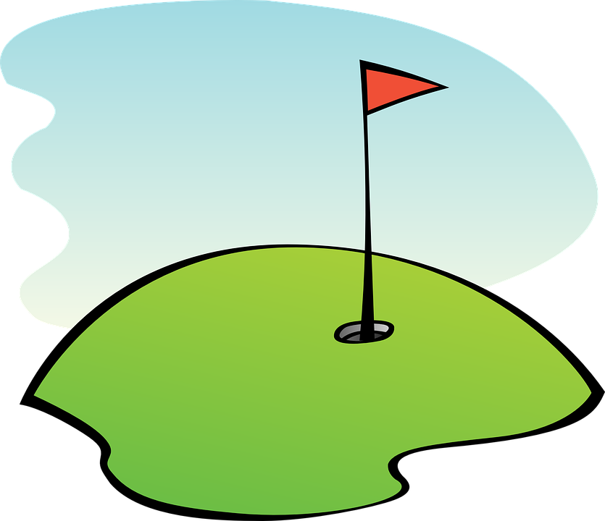
Golf Player Time Management (GPTMS)
Sprint 2 -
Collin Junkersfeld, Travis Thayer, Jakob Welchner, Luis Ramirez, Dustin Bramos, Quentin Sheets
Notes:
Speaker: Jakob

Slide 2
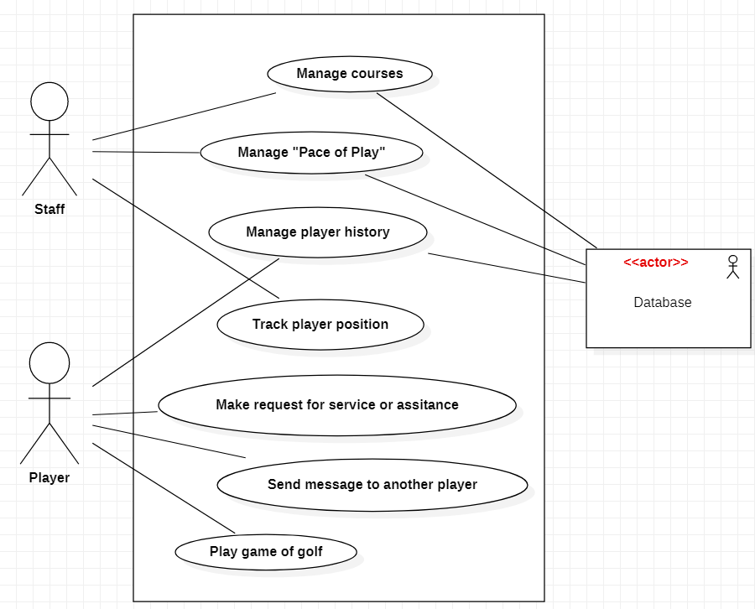
Use Case
Diagram
Notes:
Speaker: Jakob

Slide 3
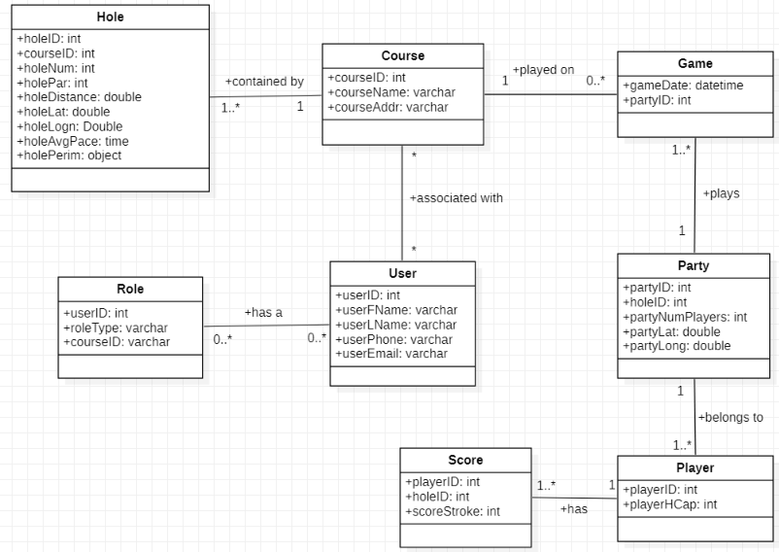
Domain Class
Diagram
Notes:
Speaker: Travis

Slide 4
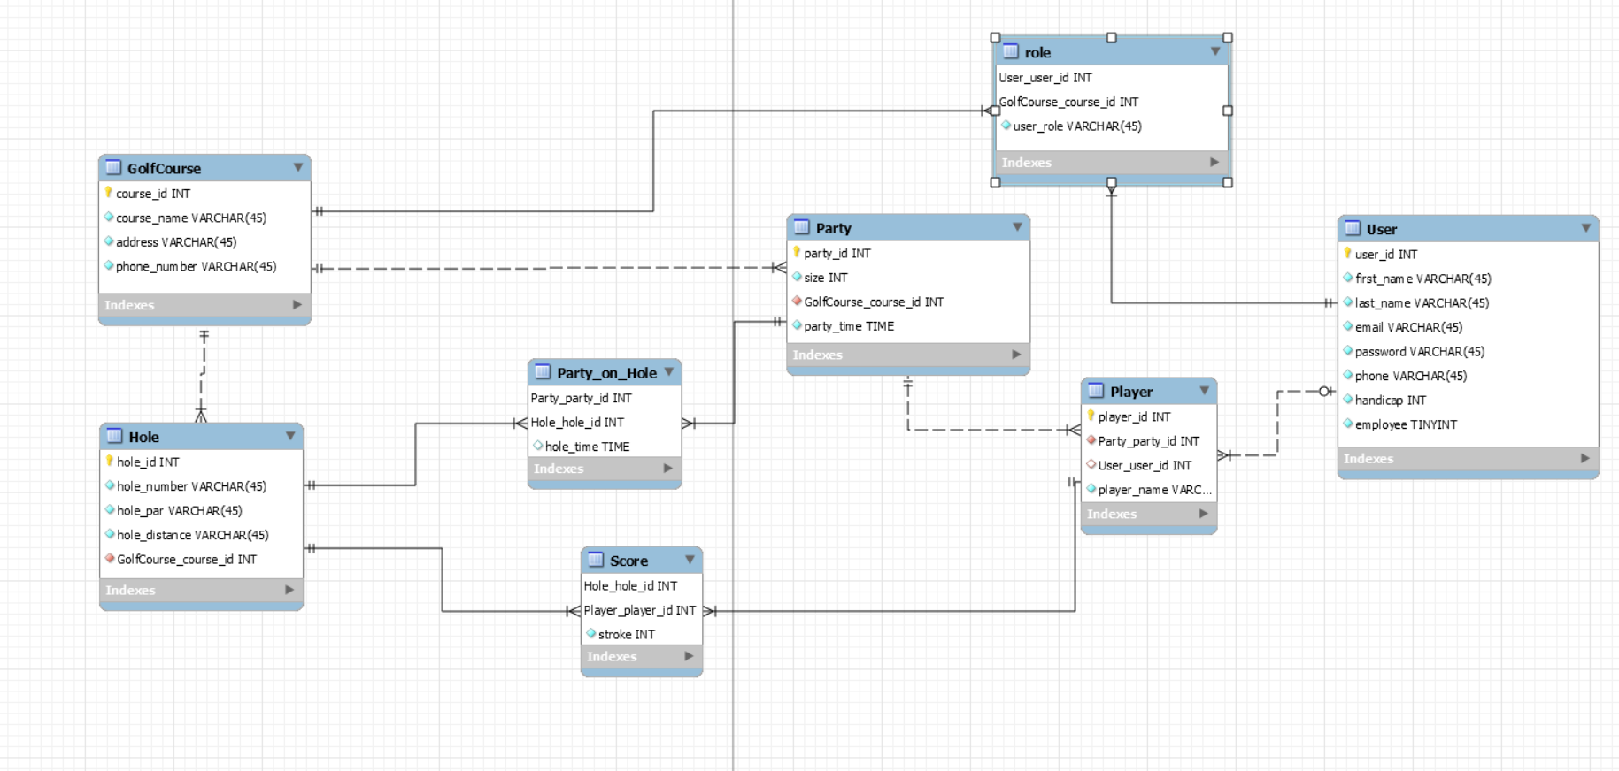
Database ERD
Notes:
Speaker: Dustin

Slide 5
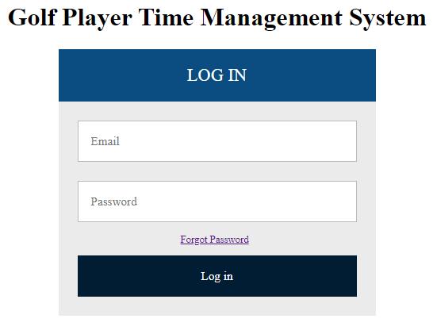
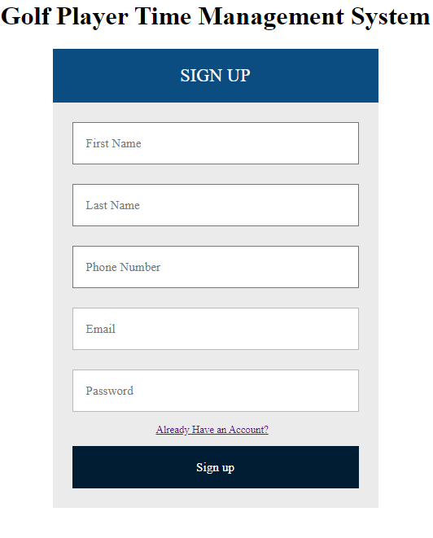
Account Creation, Registration Role Management, Profile Update, etc.
Completed User Stories
Allowing users to create an account for the application by filling out the signup form
If users already has an account, user can navigate to Login form
Login form gives option to reset password
Notes:
Speaker: Luis

Slide 6
User Stories for Next Sprint
As a player I want to be able to log into the application so that I can view dashboard/nearby courses
As a player I want to be able to start a session so that I can keep track of play on my scorecard
As a player I want to be able to view my pace and score history by golf course and date
Notes:
Speaker: Collin
Player Play Session - User logs in - User selects start a game on the dashboard - User selects golf course from drop down list - user selects front 9 or back 9 - user scorescards automatically starts them at first hole - user is instructed to click start button when they start to play - (Time clock starts) - user updates hole number on scorecard on each hole - (repeat until finish with holes) - hit stop button when golf outing is finished
Player History - User logs in - User selects ‘Player History’ from dashboard - Player Selects specific golf outing by either course or date - Player clicks either score or pace - player views data

Slide 7
QA Tests for User Authentication System
Creating a Sprint Checklist for required functionality
Testing each component before pushing to GitHub and master branch
Each team performs testing and creates of use cases that may create issues
Making sure requirements are defined for User Authentication
Notes:
Speaker: Quentin

